Slide 1
UNIVERSITY OF CONNECTICUT
Why UConn Engineering?
2023 HIGHLIGHTS
Revised 23.7.19

Slide 2
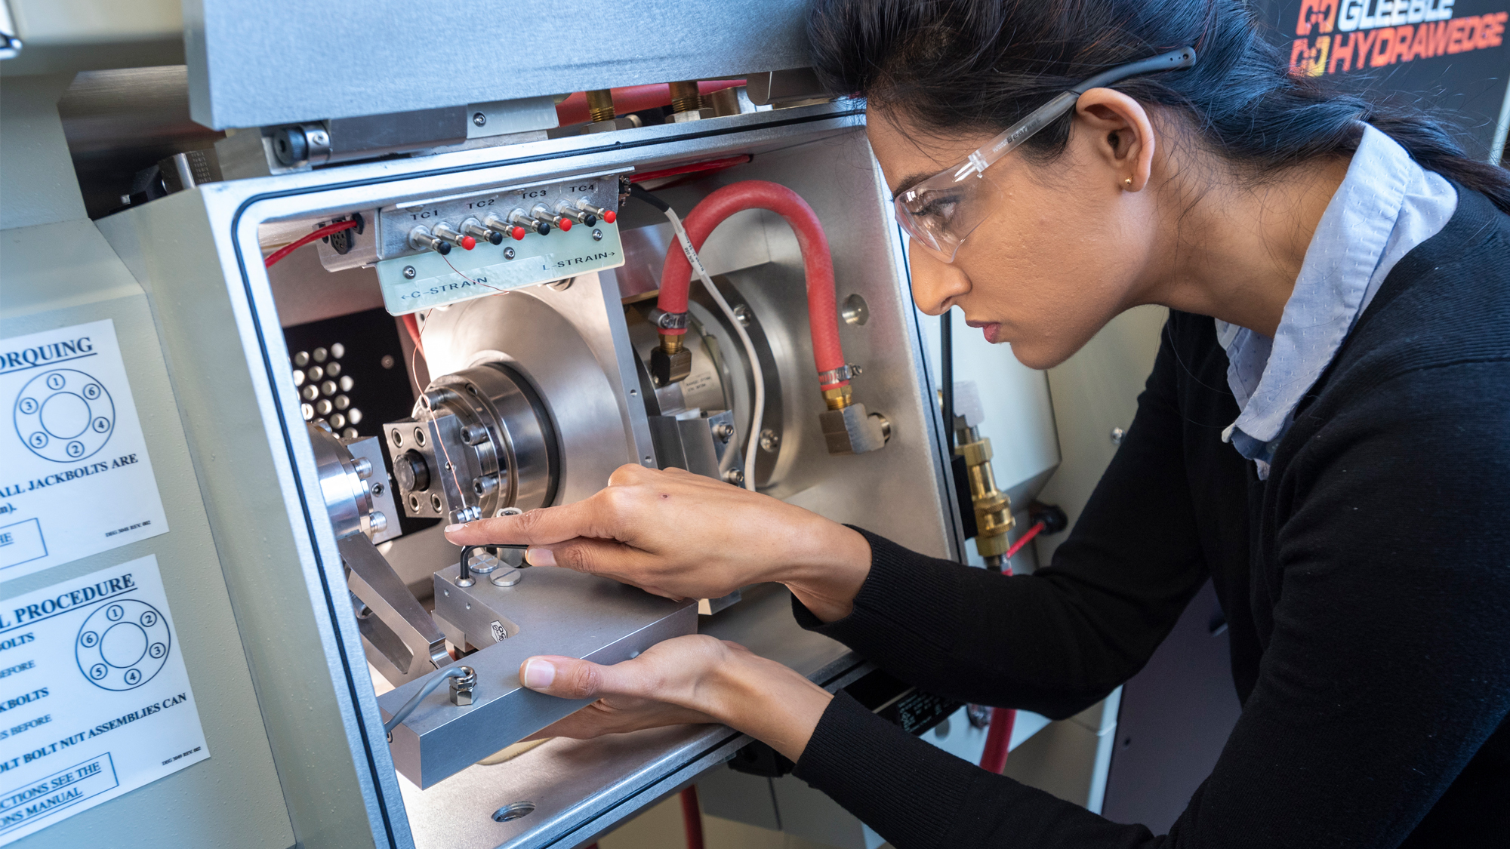
UNIVERSITY OF CONNECTICUT 2023 HIGHLIGHTS
A Top-Ranked Research Institution
Top Ranked Public University in the Nation
$2.1M spent towards renovation of all research, teaching and administrative spaces
$75M total FY 2023 research expenditure
Undergraduate student enrollment has increased by more than 65% since 2012
Best Engineering Graduate Schools ranking moved from 69th to 63rd
$12M+ in Philanthropic Development
engr.uconn.edu

Slide 3
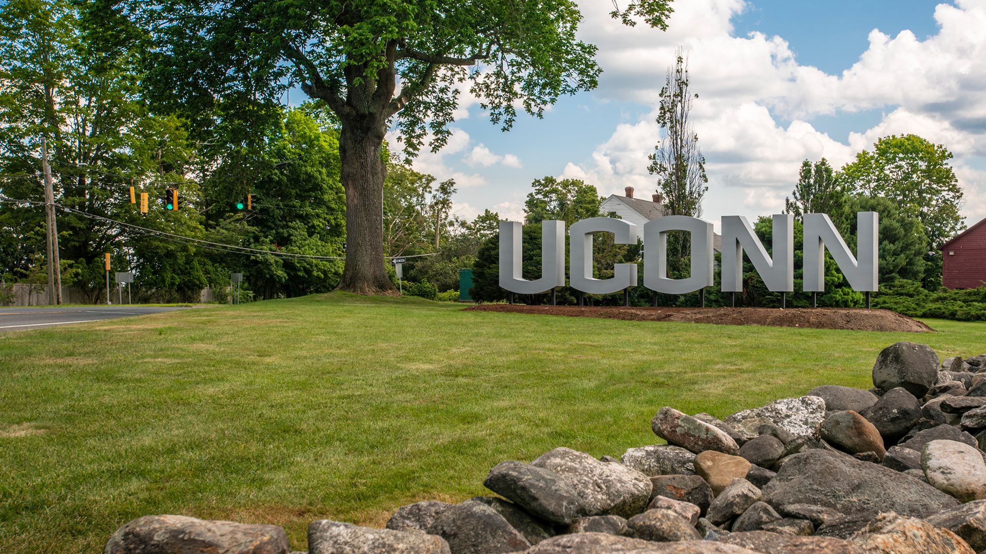
UCONN ENGINEERING 2023 HIGHLIGHTS
GROW DISCOVER CREATE
$75M Total FY 2023 Research Expenditures
$503K Average Research Expenditure per Faculty
489 Proposals submitted
480 Active Grants
engr.uconn.edu

Slide 4
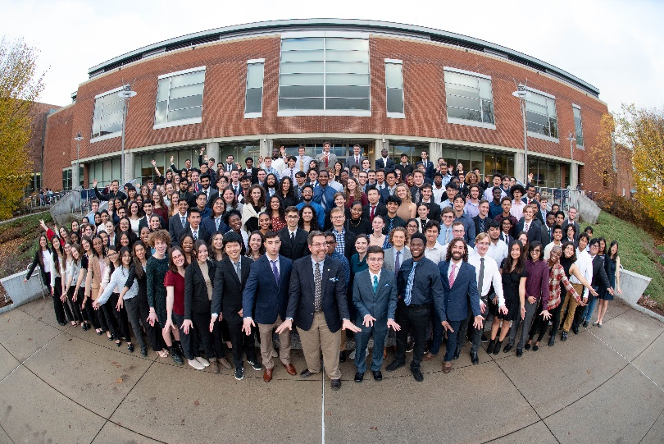
UNIVERSITY OF CONNECTICUT 2023 HIGHLIGHTS
Why UConn?
$527,000 in Scholarships Awarded to 230 Students in 2020
UConn is Among the Top 25 Public Universities in the Nation
23,000 Undergraduate Students Across All Four Regional Campuses, 19,000 at the Storrs Campus
12 Majors & 16 Minors to Choose from
Average SAT Score of Incoming Undergraduate is 1306
engr.uconn.edu

Slide 5
UNIVERSITY OF CONNECTICUT 2023 HIGHLIGHTS
Why UConn?
Graduate Stipends of Up to $40,232 Annually
Student Life
UConn is Close to Major Cities
20 Min from Manchester & Hartford
90 Min from Boston
150 Min from NYC
Award winning Recreation Center
Including Sponsored Outdoor Activities, Hiking, Skiing, Camping etc.!
World Famous Homemade Ice Cream
Over 63 Organizations for Graduate Students to Join
Family Friendly Policies
Paid Time Off Each Semester
Paid Family Leave
Full Family Health Insurance
Childcare
engr.uconn.edu

